Slide 1


K.RAMAKRISHNAN COLLEGE OF TECHNOLOGY
(AUTONOMOUS), TRICHY
BUILDING A PERSONALIZED LEARNING PATH FOR STUDENTS USING ML
PRESENTED BY 2303811714821058 – B.R.VIMAL AANANTH
GUIDED BY
Mr. R.ROSHAN JOSHUA, AP/AI
Notes:
1

Slide 2
PRESENTATION OVERVIEW
Problem Identification and formation
Objective
Block diagram of proposed system
Architecture Diagram
Machine learning techniques used
Module Implementation
Module Description
Modules Designed
ML Algorithm Identification
Source Code
Screenshots
Conclusion and Future Enhancement
Notes:
2

Slide 3
PROBLEM IDENTIFICATION AND FORMATION
The goal is to develop a system that builds a personalized learning path for students using machine learning. Current educational systems follow a "one-size-fits-all" approach, which does not cater to individual student needs. A machine learning-based system can :
Identify individual learning styles.
Adapt learning materials.
Provide personalized content and recommendations.
Improve student engagement and performance by optimizing the learning experience.

Slide 4
OBJECTIVE
The system's objective is to:
Identify learning patterns of students.
Customize learning paths based on the strengths, weaknesses, and preferences of each student.
Predict areas of improvement and suggest personalized study material.
Track student progress and adjust the learning path dynamically.

Slide 5
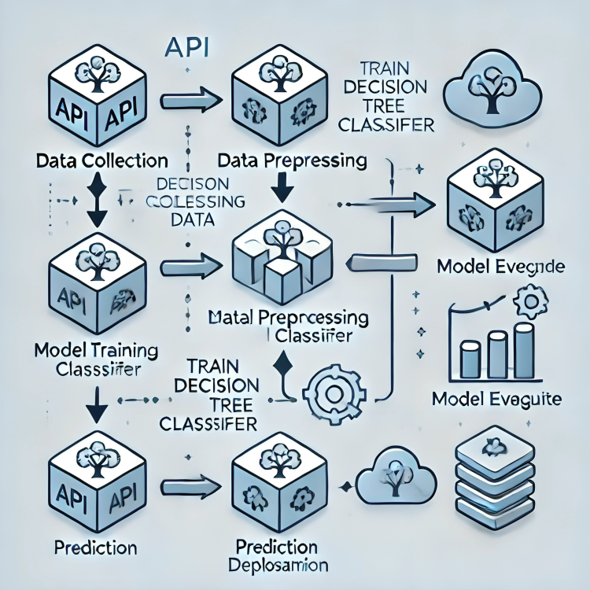
PROPOSED SYSTEM
BLOCK DIAGRAM

Slide 6
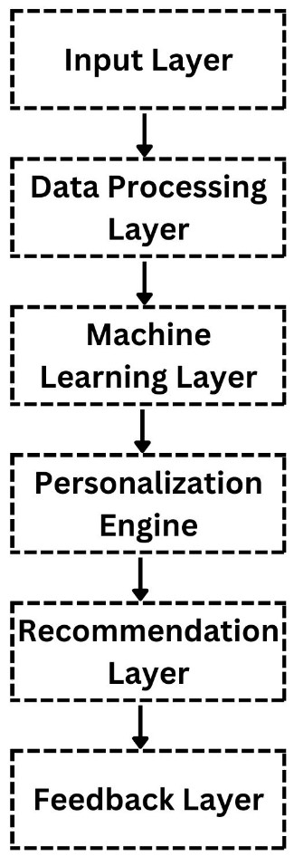
ARCHITECTURE DIAGRAM

Slide 7
MACHINE LEARNING TECHIQUES USED
Clustering : K-Means Clustering: Groups students based on learning behaviors, strengths, and weaknesses.
Collaborative Filtering : Recommends study materials and assignments based on similar students’ preferences and past interactions.
Classification Algorithms : Decision Trees / Random Forest: Predict areas where students may struggle and suggest remedial actions.
Reinforcement Learning : Personalizes learning paths dynamically using feedback from student progress.
Natural Language Processing (NLP) : Analyzes student feedback and interactions with text-based materials to suggest personalized content.

Slide 8
MODULE IMPLEMENTATION
Data Collection : Create APIs or integrate with LMS to gather data on course progress, quizzes, and student interactions.
Preprocessing : Clean and normalize data using tools like Pandas and Scikit-learn.
Learning Path Generator : Use classification algorithms to predict and assign the next learning steps.
Recommendation Engine : Apply collaborative/content-based filtering to recommend personalized resources.
Progress Tracking : Monitor progress in real-time and adjust learning paths dynamically.
Feedback Module : Use NLP to analyze feedback and improve recommendations.

Slide 9
MODULE DESCRIPTION
Data Collection : Captures learning behavior, assessment scores, and feedback.
Preprocessing : Cleans and prepares data for machine learning models.
Learning Path Generator : Personalizes learning journeys based on student performance.
Recommendation Engine : Suggests resources based on student needs.
Progress Tracking : Monitors progress and updates learning paths.
Feedback Module : Refines the system using student feedback.
Notes:
9

Slide 10
MODULE DESIGNED
User Profile Module : Stores information about student preferences, learning styles, and past performance.
Progress Analytics Module : Provides analytics and reports on student progress to teachers and students.
Content Matching Module : Matches course content with the student’s current learning path and recommendations.
Notes:
10

Slide 11
ML ALGORITHM IDENTIFICATION
The main machine learning algorithms used in the system include:
K-Means Clustering : To group students with similar learning behaviors.
Decision Trees : To classify students based on their strengths and weaknesses.
Collaborative Filtering : To recommend learning materials.
Reinforcement Learning : To adapt and improve the learning path based on student interaction.
Notes:
11

Slide 12
SOURCE CODE
# Import necessary libraries
from sklearn.tree import DecisionTreeClassifier
import numpy as np
data = np.array([
[1, 1, 1, 0, 0, 0],
[1, 0, 0, 1, 0, 1],
[0, 1, 1, 0, 0, 0],
[0, 0, 0, 1, 0, 1],
[1, 1, 0, 0, 1, 0],
[1, 0, 0, 0, 1, 0],
[0, 0, 0, 0, 0, 1],
[1, 1, 1, 1, 1, 1],
[0, 0, 1, 1, 0, 0],
[0, 0, 0, 0, 1, 0],
])
Notes:
12

Slide 13
SOURCE CODE
labels = [
"Engineering and Technology Path",
"Arts and Creative Design Path",
"Computer Science Path",
"Graphic Design Path",
"Medical Research Path",
"Health Science Path",
"Fine Arts Path",
"Comprehensive Multi-Disciplinary Path",
"Web Development and UI/UX Path",
"Pure Medical Sciences Path",
]
Notes:
13

Slide 14

model = DecisionTreeClassifier()
model.fit(data, labels)
print("Enter your interests (1 for Yes, 0 for No):")
science = int(input("Do you enjoy Science? (1/0): "))
math = int(input("Do you enjoy Mathematics? (1/0): "))
programming = int(input("Do you enjoy Programming? (1/0): "))
design = int(input("Do you enjoy Design? (1/0): "))
biology = int(input("Do you enjoy Biology? (1/0): "))
creativity = int(input("Do you enjoy Creativity and Arts? (1/0): "))
user_input = np.array([[science, math, programming, design, biology, creativity]])
recommendation = model.predict(user_input)
print("\nRecommended Learning Path for You: ", recommendation[0])
Notes:
14

Slide 15
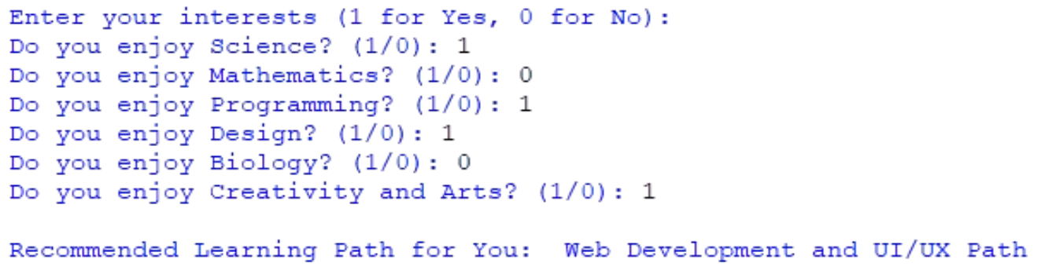
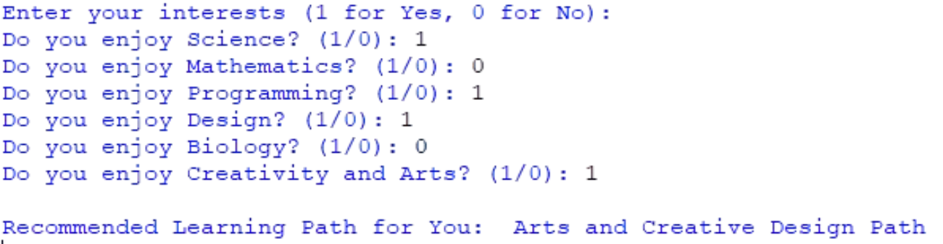
SCREENSHOTS
Notes:
15

Slide 16
Conclusion
The personalized learning path system uses machine learning to tailor education to individual students, improving engagement and performance by recommending resources, tracking progress, and refining learning paths based on feedback.
Future Enhancements
Adaptive Assessments
Gamification
Multi-Platform Integration
AI Chatbot Support
Advanced Predictive Analytics
Cross-Domain Learning

Slide 17
THANK YOU
Notes:
17

